Slide 1
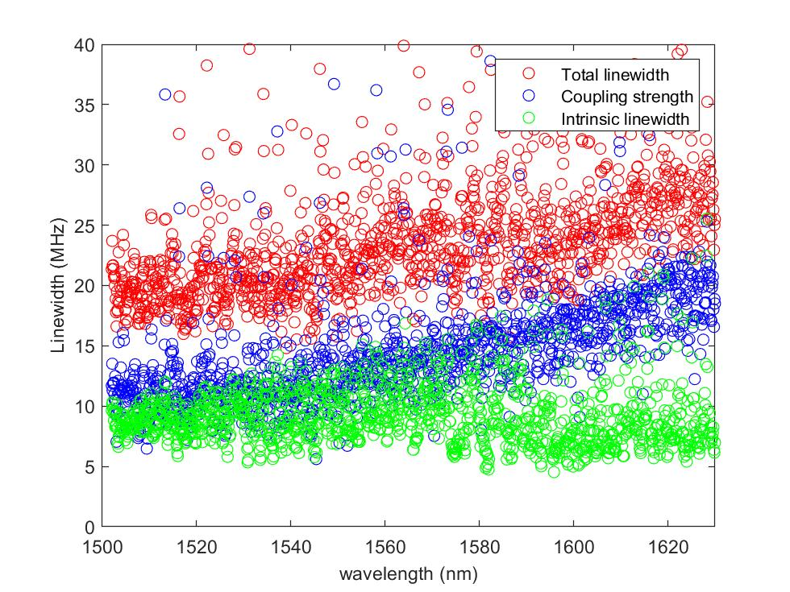
12 GHz Si₃N₄ Microresonator: Characterization
Chip number: D63_3_12GHz_F4_C12
In the range around 1542 nm
Total linewidth κ/2π ≈ 20 MHz
Intrinsic linewidth κ₀ /2π ≈ 8 MHz

Slide 2
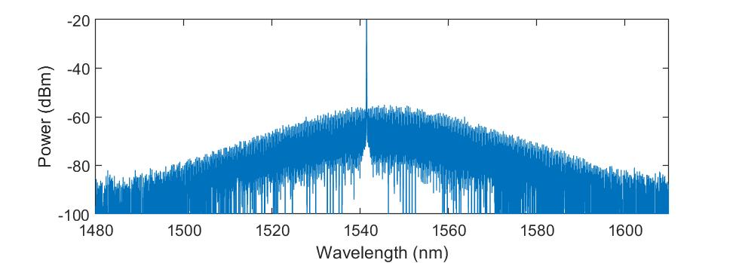
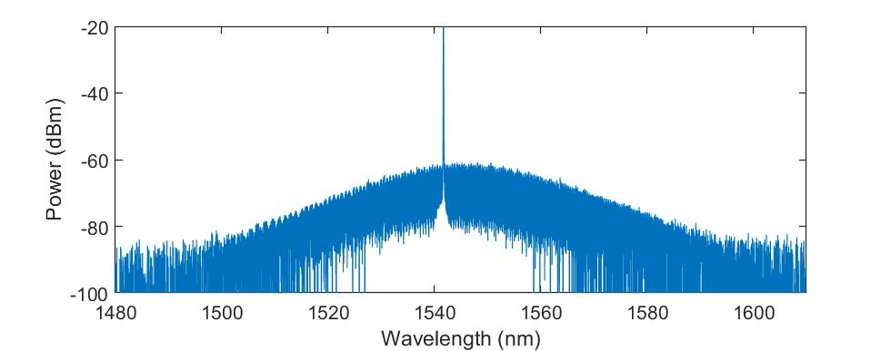
12 GHz Si₃N₄ Microresonator: soliton generation
All the resonances around 1542 nm can generate multi/single soliton with
pump power above 400 mW (i.e. on chip power above 200 mW)
λp=1542.0 nm
Pin=400 mW
λp=1542.3 nm
Pin=400 mW

